Slide 1
Classifying Disaster Tweets
Group 7
By Jeffrey Hu and Ajinkya Patil

Slide 2
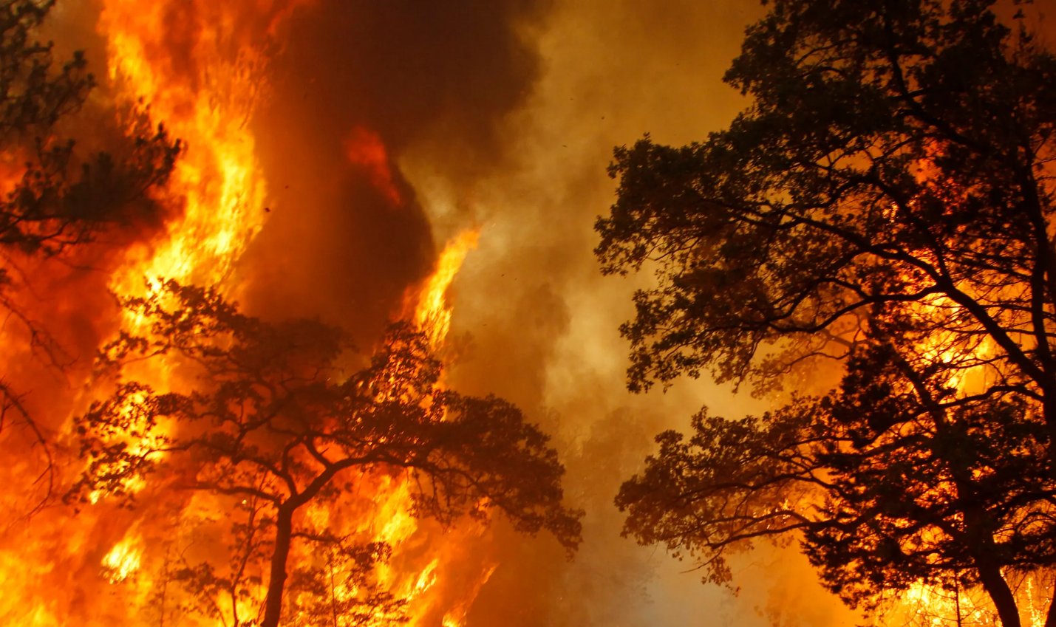
Dataset Description
The “Natural Language Processing with Disaster Tweets” dataset sourced from kaggle consists of 10873 tweets with three features (not including “id”) and the target variable [0 for unrelated disaster tweet, 1 for disaster tweet]. We chose to do this text classification problem due to the increase in misinformation on today’s social media platforms.
The tweets from the dataset could either be related to the disaster, consisting of natural disasters (like earthquakes, hurricanes, or wildfires), extreme weather events (like heat waves and storms), or man-made disasters (like oil spills and transportation accidents). Or, the tweets could be completely unrelated to disasters, which would be classified as a fake disaster tweet.
The three features of our dataset include ‘text’ (the body of the tweet), ‘location’ (where the tweet was sent from), and ‘keyword’ (most notable word of the tweet relating to a disaster).

Slide 3
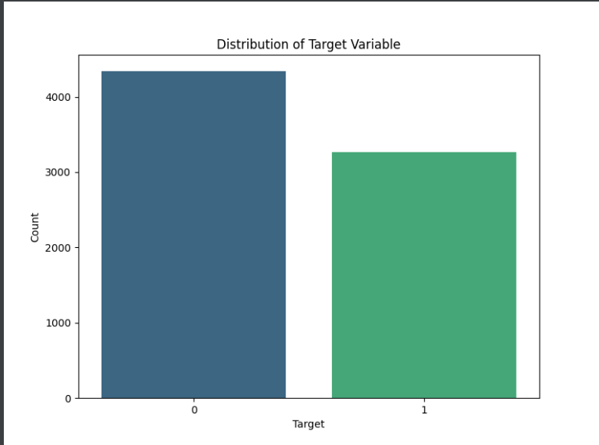
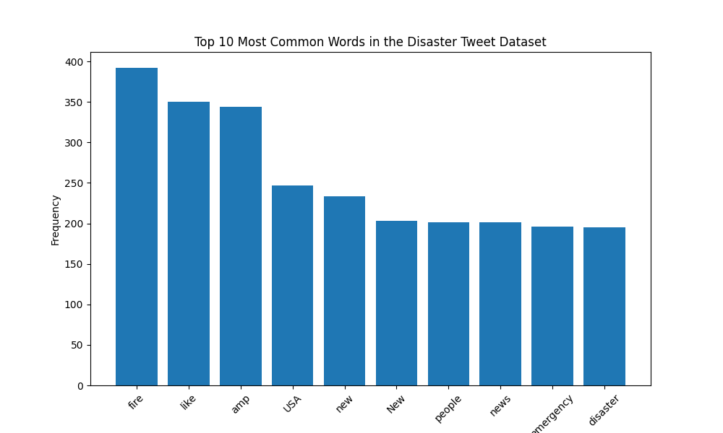
Dataset/EDA
Mostly balanced distribution, 4342 with target:0, 3271 with target:1
Most frequent words include ‘Fire’, ‘amp’, ‘USA’, ‘emergency’, ‘disaster’, after filtering out stop words and lemmatizing

Slide 4
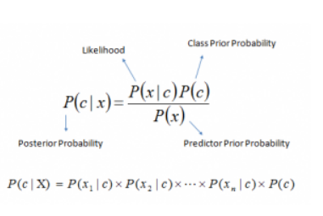
Naive Bayes
Naive Bayes is a probabilistic algorithm based on bayes theorem, which calculates the probability of hypothesis given the observed evidence.
The naive in Naive Bayes comes from the assumption that features are conditionally independent.
Naive Bayes calculates the probability of a document belonging to a particular class by multiplying the probabilities of each word occurring given that class.

Slide 5
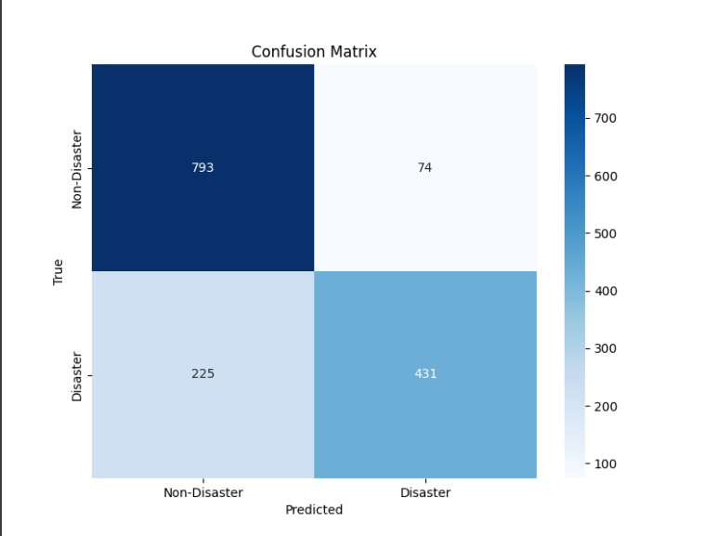
Confusion matrix for naive bayes

Slide 6
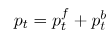
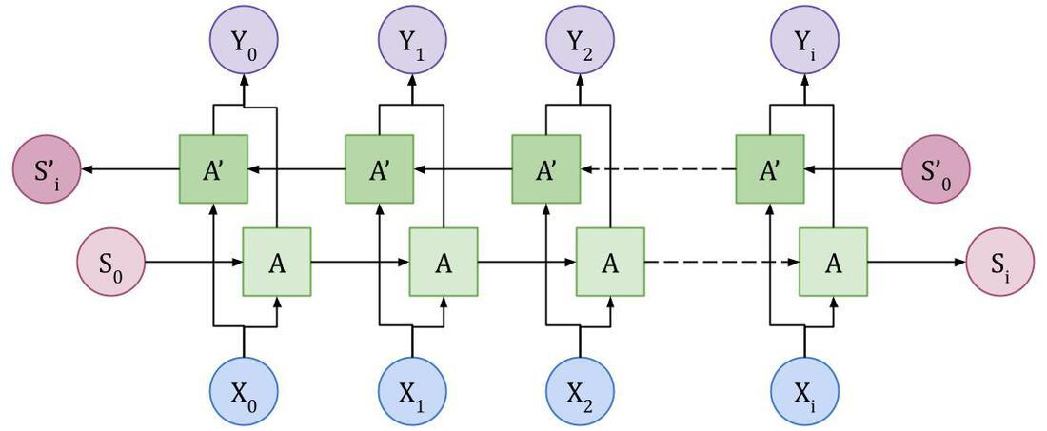
Bidirectional LSTM
A sequence model which contain two LSTM, one for processing input in forward direction and the other for processing in the backward direction.
The intuition behind this approach is that by processing data in both directions, the model is able to understand the relationship between sequences.
The final output given by the bidirectional lstm is combination of the probabilities of the two LSTMs
Where pt = final probability vector, ptf = probability of forward LSTM ptb = probability of backward LSTM.

Slide 7
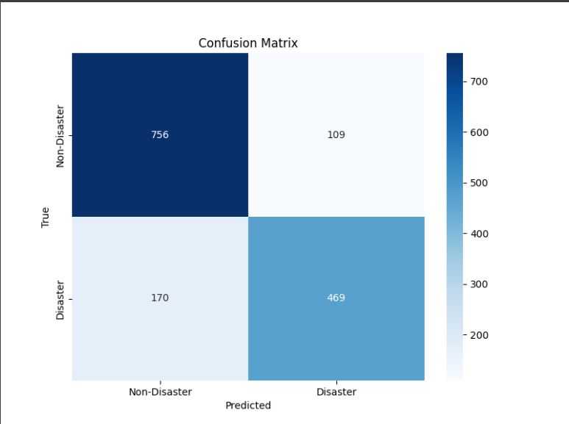
Confusion matrix for Bilstm

Slide 8
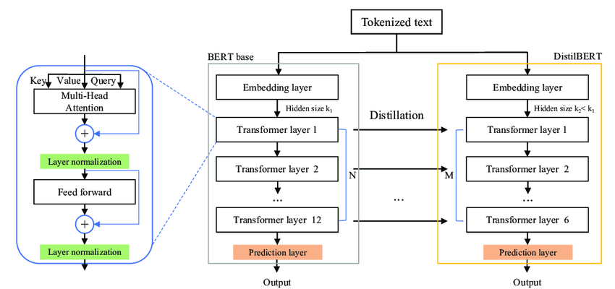
DistilBERT
Distilled Version of the BERT, trained from the original model w/ Knowledge Distillation
40% lighter, 60% faster, 97% of the language capabilities of BERT
Same general architecture, layers reduced by 2 times

Slide 9
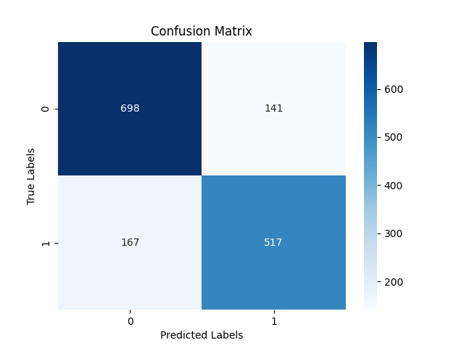
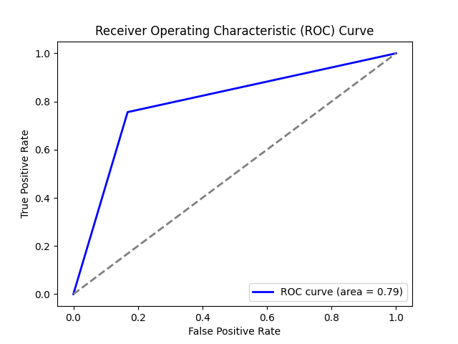
Confusion Matrix/ROC for DistilBERT
F1=.80

Slide 10
Challenges/Future Direction
In the dataset distribution, some words that did not necessarily indicate a disaster were disproportionately associated with disasters (i.e. attention)
Due to filtering out stopwords using Spacy, past and present tense were ambiguous to the model in some situations, so that past disasters and on-going disasters were treated the same (I was in a car accident vs. I am in a car accident)
Automate disaster classification on tagged tweets (to check to see if tweets were improperly/mistakenly tagged)
Further classify positively predicted tweets (between which type of disaster it is, and which resource is best suited to the disaster

